Slide 1
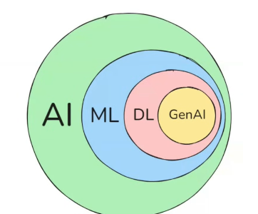

π
Model Context Protocol(Mcp)
Langchain
Notes:
Content: https://www.linkedin.com/pulse/chunking-strategies-ai-data-kash-kashyap-0lghe/

Slide 2
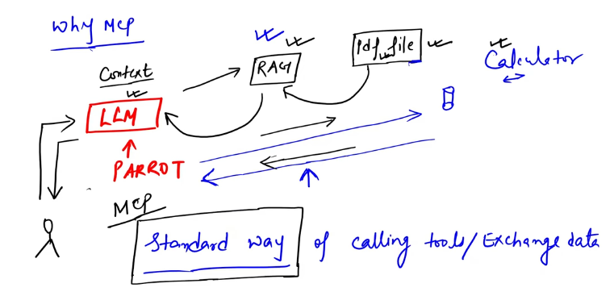
MCP(Model Context Protocol)
Chains are a series of steps and action
MCP provides a standardized way to connect AI applications to external systems.
Notes:
Content: https://www.linkedin.com/pulse/chunking-strategies-ai-data-kash-kashyap-0lghe/

Slide 3
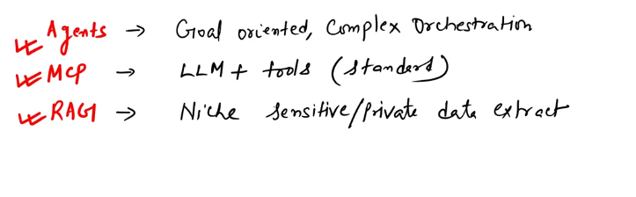
Notes:
Content: https://www.linkedin.com/pulse/chunking-strategies-ai-data-kash-kashyap-0lghe/

Slide 4
Notes:
Content: https://www.linkedin.com/pulse/chunking-strategies-ai-data-kash-kashyap-0lghe/

Slide 5
π
open-source framework
introduced by Anthropic in Nov2024
standardize the way how large language models (LLMs) integrate and share data with external tools, systems, and data sources
MCP provides a universal interface for reading files, executing functions, and handling contextual prompts
MCP enables developers to expose their data via MCP servers to develop AI applications—referred to as MCP clients
MCP also plays a critical role in multi-tool agent workflows, allowing agentic AI systems to coordinate multiple tools
Notes:
Content: https://www.linkedin.com/pulse/chunking-strategies-ai-data-kash-kashyap-0lghe/

Slide 6
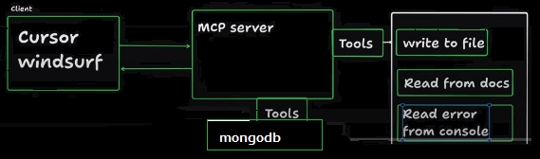
π
Model Context Protocol
MCP provides a standardized way to connect AI models to different data sources and tools to help us build agents and complex workflows on top of LLMs.
When we use LLMs, they'll need to integrate with a variety of different tools and data sources. MCP provides a list of pre-built integrations that we can integrate with LLMs.

Slide 7
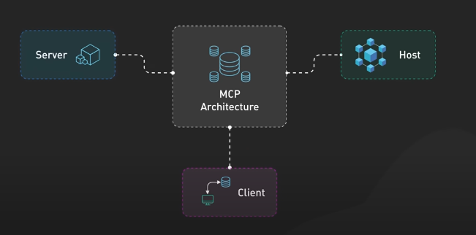
π
MCP Architecture
Notes:
Content: https://www.linkedin.com/pulse/chunking-strategies-ai-data-kash-kashyap-0lghe/

Slide 8
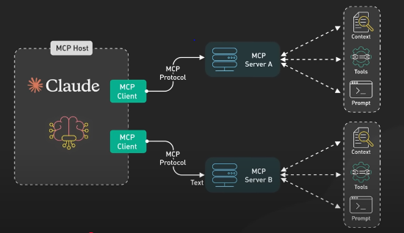
π
Host are LLM applications like Claude desktop that provide the environment for connections.
Clients are components within the host that establish and maintain one to one connections with external servers
Servers are separates processes that provide context, tools and prompts to theses clients ,exposing specific capabilities through the standardized protocol
Notes:
Content: https://www.linkedin.com/pulse/chunking-strategies-ai-data-kash-kashyap-0lghe/

Slide 9
π
Notes:
Content: https://www.linkedin.com/pulse/chunking-strategies-ai-data-kash-kashyap-0lghe/

Slide 10
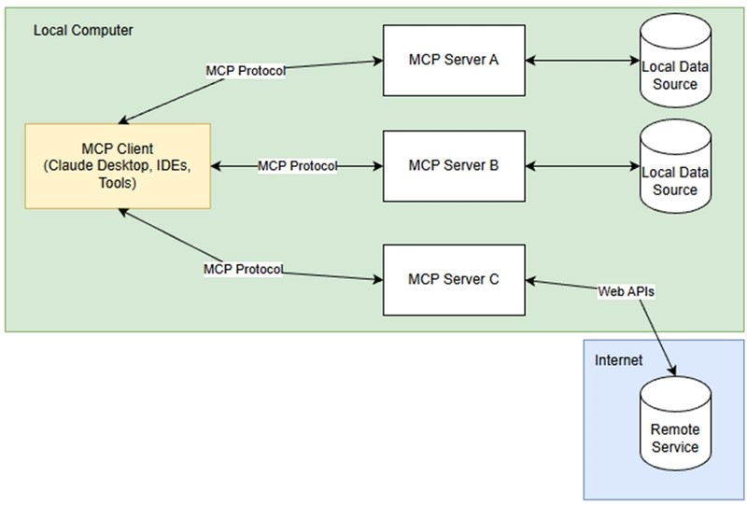
π
How does it work?
MCP follows a client-server architecture where a host can connect to multiple servers. Take a look at the diagram below:
Notes:
Content: https://www.linkedin.com/pulse/chunking-strategies-ai-data-kash-kashyap-0lghe/

Slide 11
π
MCP hosts like Claude Desktop, IDEs, or other AI tools act as clients that maintain connections to MCP Servers that expose capabilities through the MCP Protocol.
Clients maintain 1-to-1 connections with servers inside the host application.
MCP servers can connect to data that's hosted locally (like your filesystem, databases etc.) or remotely (such as API's or remote databases) over the internet.
Notes:
Content: https://www.linkedin.com/pulse/chunking-strategies-ai-data-kash-kashyap-0lghe/

Slide 12
π
MCP has a protocol layer that handles message framing, request/response linking, and high-level communication patterns, and a transport layer that handles communication between clients and servers.
There are two transport mechanisms that MCP supports:
1. Stdio transport
This uses standard input/output transport for communication, which is ideal for local processes.
2.HTTP with SSE transport
This uses Server-Sent Events (SSE) for server-to-client messages, and HTTP POST for client-to-server messages.
Both transports use JSON-RPC 2.0 to exchange messages.
Notes:
Content: https://www.linkedin.com/pulse/chunking-strategies-ai-data-kash-kashyap-0lghe/

Slide 13
π
Resources
Resources in MCP allow servers to expose data and content that can be read by clients and that is used as context for LLM interactions
They represent any kind of data that an MCP server want to make available to clients, including:
File contents
API responses
Database records
Images
and more!
Notes:
Content: https://www.linkedin.com/pulse/chunking-strategies-ai-data-kash-kashyap-0lghe/

Slide 14
π
Prompts
Prompts enable servers to define reusable prompt templates and workflows that clients can surface to users and LLMs. This provides a mechanism to standardize common interactions with LLMs.
Prompts in MCP can accept dynamic arguments, include context from resources, and chain multiple interactions.
Notes:
Content: https://www.linkedin.com/pulse/chunking-strategies-ai-data-kash-kashyap-0lghe/

Slide 15
π
Tools
Tools enable LLMs to perform actions through your MCP server. They expose functionality to clients, and allow LLMs to interact with external systems, perform computations, and take actions.
Tools are exposed from servers to clients to enable LLMs to directly invoke them.
Tools can be discovered by clients, and invoked to perform operations. Tools can range in complexity, from performing simple calculations to complex API interactions.
Notes:
Content: https://www.linkedin.com/pulse/chunking-strategies-ai-data-kash-kashyap-0lghe/

Slide 16
π
Notes:
Content: https://www.linkedin.com/pulse/chunking-strategies-ai-data-kash-kashyap-0lghe/

Slide 17
π
Notes:
Content: https://www.linkedin.com/pulse/chunking-strategies-ai-data-kash-kashyap-0lghe/

Slide 18
π
Notes:
Content: https://www.linkedin.com/pulse/chunking-strategies-ai-data-kash-kashyap-0lghe/

Slide 19
π
Notes:
Content: https://www.linkedin.com/pulse/chunking-strategies-ai-data-kash-kashyap-0lghe/

Slide 20
π
Notes:
Content: https://www.linkedin.com/pulse/chunking-strategies-ai-data-kash-kashyap-0lghe/

